Slide 1

‘암기하장’
Mobile Programming
Final presentation
김서윤, 임예슬

Slide 2
Index
Description of the application
Motivation
Composition of the application
Feature of the application
Related works
Video Demonstration

Slide 3

1. Description of the application
Memorizing words on my way
want to memorize words efficiently.
want to check their learning level for themselves.
wants to study my weak points more intensively.
wants to have the most optimal memory for me.

Slide 4
2. Motivation
We want to make the most optimal memory for us
We need to memorize all sentences sometimes.
There aren’t many memorization apps for both ‘words’ and ‘sentences ’in market.
We want to memorize only what we need.

Slide 5
2. Advantages
categorize contents
Test → show wrong answer → we can know weak point
Comfortable UI
Mark important contents → assemble into one page
Provide manuals
add and learn what we want to memorize
Search / Share contents
Store and See contents without internet
For both words and sentences
Wrong note → learn about weak point
Memorize sentence using ‘blank’
add and learn what we want to memorize

Slide 6
3. Composition of the application
Interface
search / share contents
Add contents
Show contents
Interface
add category
add words/sentences
Database
show words/sentences
set bookmark
Interface
translation → use Papago API
extract text from images
Interface
Test contents
add wrong note
create test and scoring
Test
Layout
CoordinatorTabLayout open source
constraint layout
navigation view, … etc

Slide 7
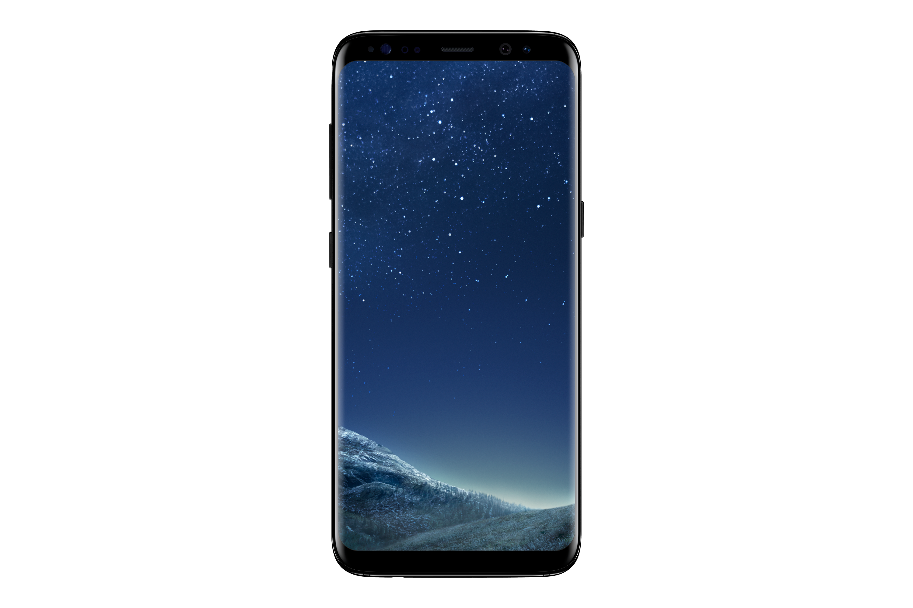
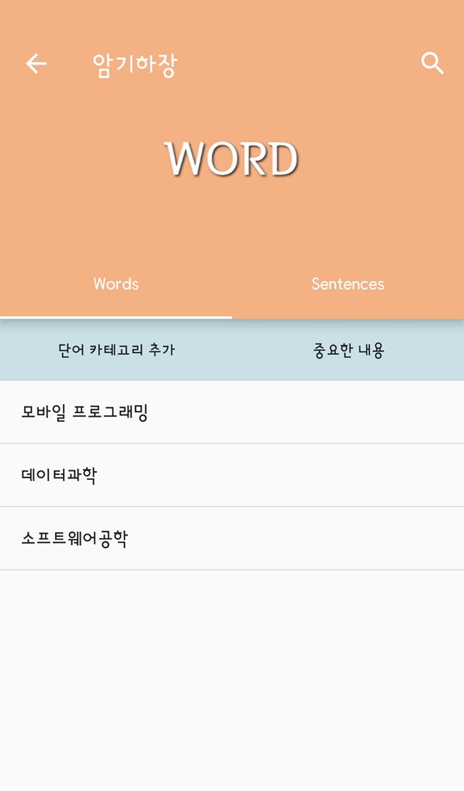
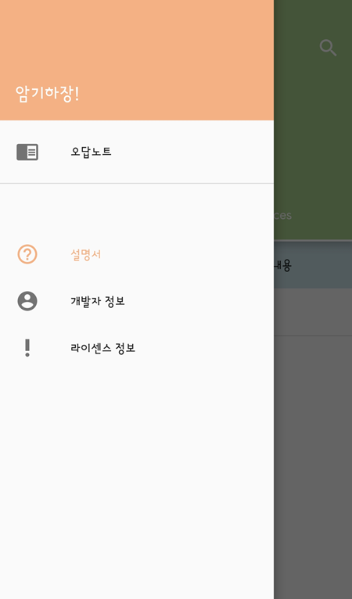
4. Feature of the application
* use list view and fragment for tab layout
Main View
check where your contents is stored
through the search function.
choose between words and sentences
depending on the type of content.
Marked words are stored
Manuals are provided.

Slide 8
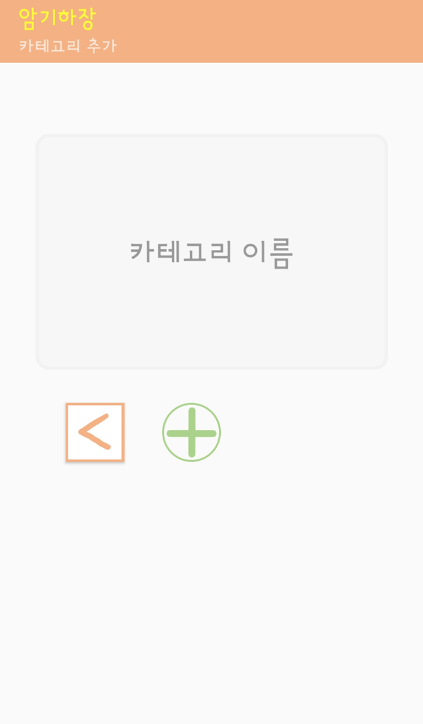
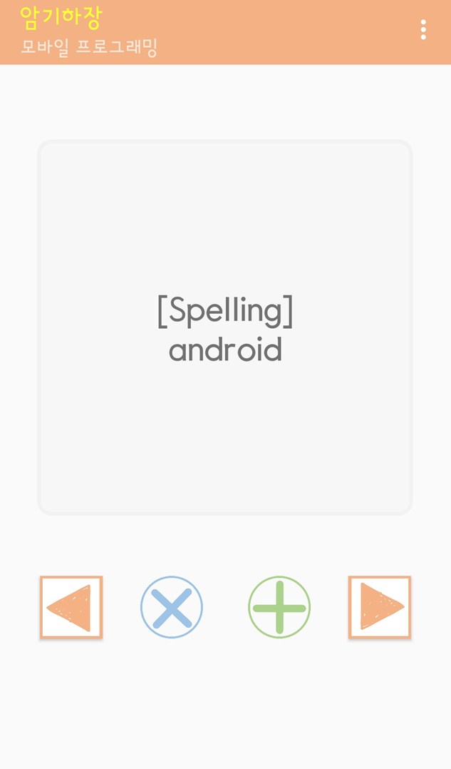
4. Feature of the application
* use click event and database
Add category
word
see the meaning by clicking on the card.
click on the card for a long time, it will be stored in important content.
move to the previous or next card
by clicking the button.
Notes:
카드를 클릭해서 뜻을 볼 수 있다.
카드를 오래 클릭하면, 중요한 내용에 저장된다.
버튼을 클릭하면 이전 혹은 다음 카드로 넘어갈 수 있다

Slide 9
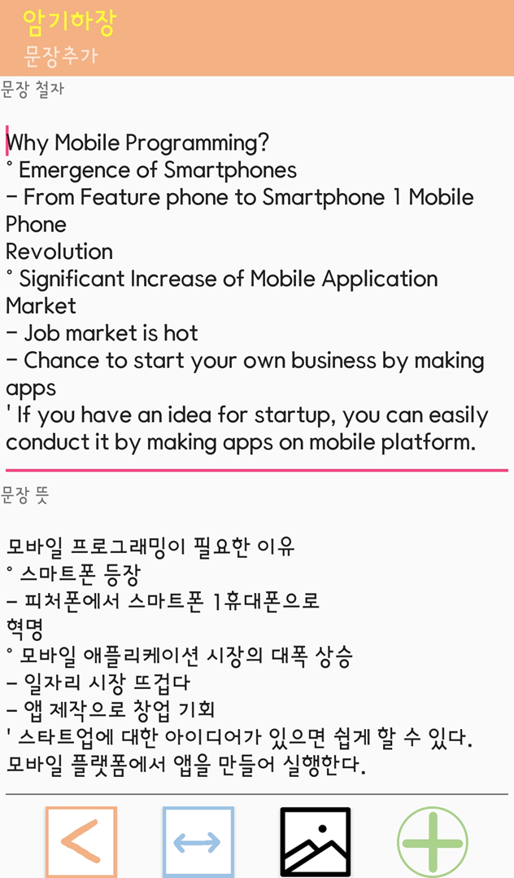
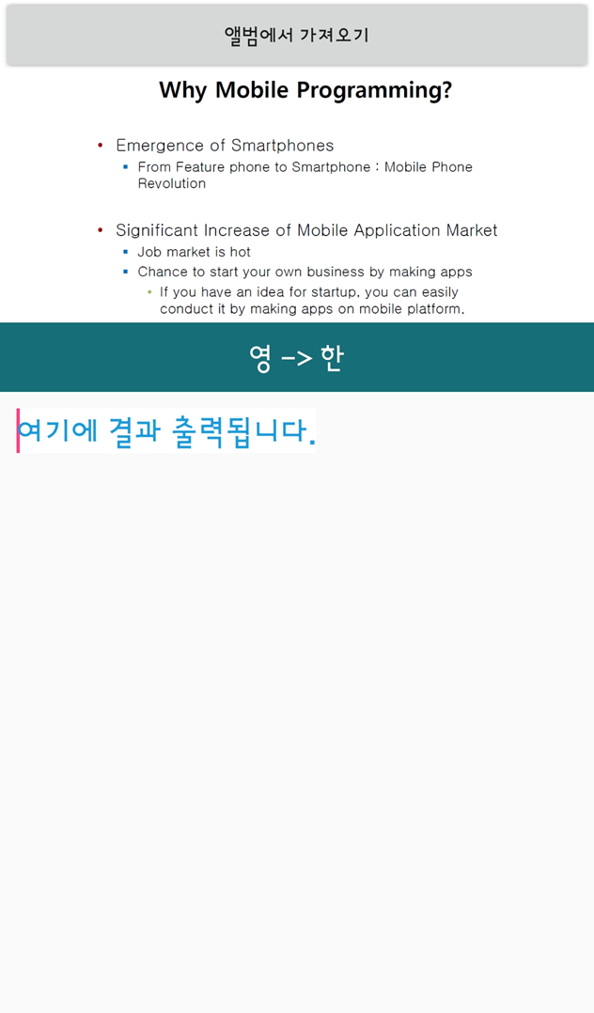
4. Feature of the application
* use OCR & Papago API
Add sentence
Extract and save text from images
Using OCR API
translate into English-Korean right away
Using papago API
Notes:
OCR API를 사용해서 이미지로부터 텍스트를 추출한다
파파고 API를 사용해서 즉시 영한 번역을 해준다

Slide 10
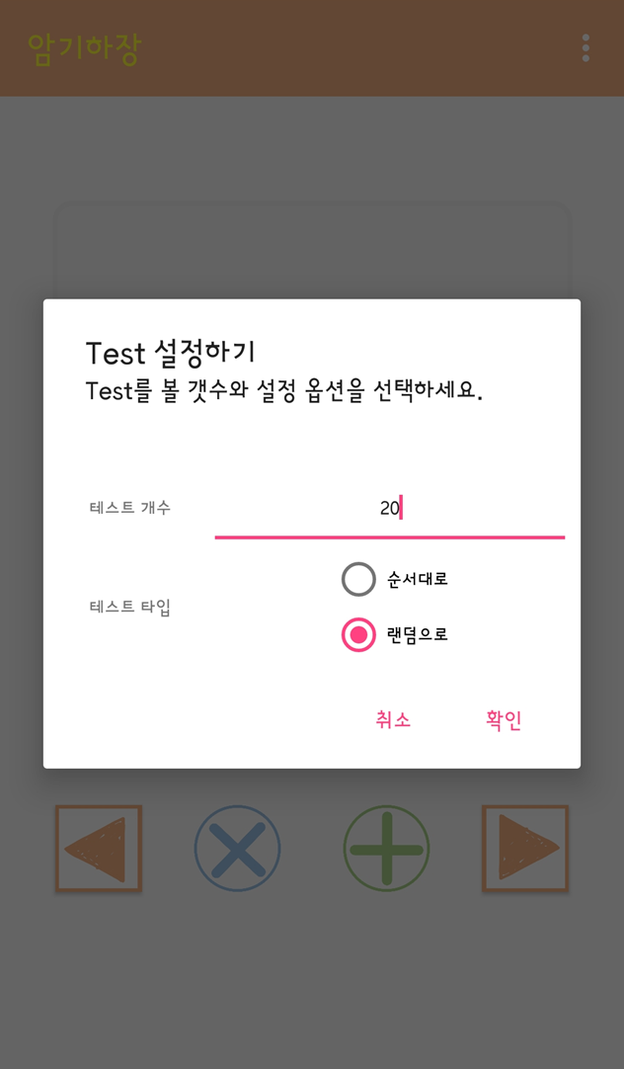
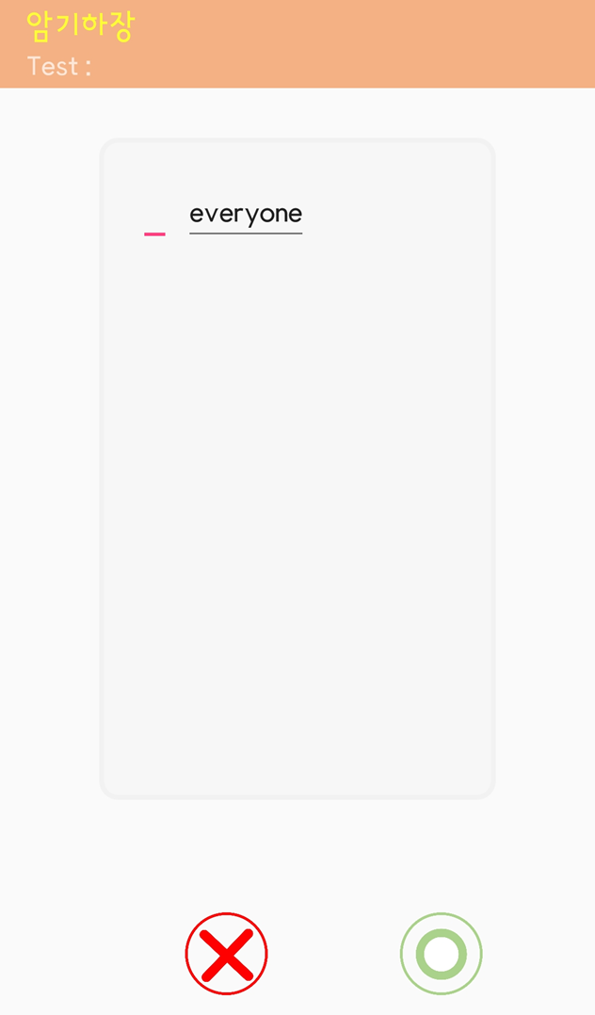
4. Feature of the application
* create table rows and edit text dynamically
Make a test paper
Take a test
Set options for testing (Random or in regular order)
Press O button if you know the contents,
or x button if you don't know.
wrong more than 4 times,
saved in the wrong answer note.
learn by clicking on a word long and blank.
long click → make a blank → type a contents → click ‘O’ button
→ grade test papre → show wrong answer
Notes:
OCR API를 사용해서 이미지로부터 텍스트를 추출한다
파파고 API를 사용해서 즉시 영한 번역을 해준다
단어를 길게 클릭해 빈칸으로 만들어 학습한다

Slide 11



5. Related works
Difference
Features
other apps
our app
O
O
X
O
O
O
- search meaning
- comfortable UI
- memorization of empty spaces
O
X
OO
- text can be extracted from the image - randomly / in regular order generated blank
Only random
O
X
X
X
OOOO
- create spaces where you want - description of use - comfortable UI - Rare errors
Notes:
OCR API를 사용해서 이미지로부터 텍스트를 추출한다
파파고 API를 사용해서 즉시 영한 번역을 해준다
단어를 길게 클릭해 빈칸으로 만들어 학습한다

Slide 12
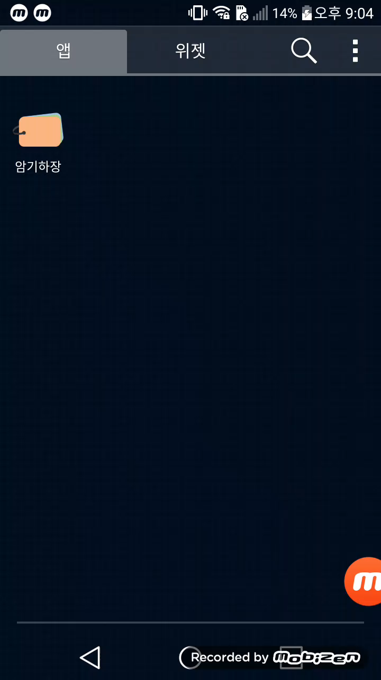
6. Video Demonstration
- Search view
- Coordinator tab layout
- Papago API
- Dynamically create view
- Tool bar
- View pager
- Navigation View
- DrawerLayout
- Implicit/Explicit intent
- many other views / listeners / events

Slide 13
Thank you

